Slide 1

Cash and A/R Part 2 - Video

Slide 2
Transfer of Receivables

Slide 3
Transfers of receivables
What is a transfer of receivables (other terms often used include factoring or securitizing receivables)?
Selling your receivables for cash now, or using receivables as collateral for a loan.
Why would a firm transfer receivables?
Prefer cash today versus waiting to collect
There is a cost…
Notes:
What? Sell A/R (future cash flows) for cash today
Why?
-Many firms w/large A/R not in the business of collecting, rather have $ now
-Other firms are in the business of collecting, optimizes for them to do so
-E.g. retail stores (GAP, target, etc.), car dealerships, etc. (think store credit cards, customer financing)
Let’s say I have $1M and I am good at making loans.
I loan my $1M to someone to buy a house
But now I’m out of money.
So I sell my receivable to someone who wants slow, steady cash flows (pensions?)
Now I have more money and can make another loan.
Downside
Now I don’t hold any risk
If my buyer can’t observe the risk of the loan I make, then why should I care whether they will pay it back not?
Mortgage crisis was like this, very opaque, lumped loans together and divided them up into high and low risk, but just comparatively, so some low risk were actually medium or high, but just lower risk compared to others.
Buyers weren’t critical enough, assumed these were safe

Slide 4
Transfers of receivables
Transfer of Receivables
Secured Borrowing
Sell/Factor
Securitize Receivables
Notes:
3 ways to get cash today from A/R
Pledge/assign (collateral)
Factor (sell receivables to 3rd party at a discount)
Securitize (bundle together and sell interest in many separate receivables)
123 of 500 firms in 2009 discuss the use of receivables to obtain financing in their annual reports
102 sold, 11 with recourse, 45 without, 46 don’t discuss recourse
21, receivables used as collateral
The “real world”: 123/500 firms in 2009 discuss the use of receivables to obtain financing in annual reports
102 sold (11 with recourse, 45 without recourse, 46 don’t mention)
21 used as collateral

Slide 5
Transfers of receivables
Transfer of Receivables
Secured Borrowing
Sell/Factor
Securitize Receivables
Notes:
3 ways to get cash today from A/R
Pledge/assign (collateral)
Factor (sell receivables to 3rd party at a discount)
Securitize (bundle together and sell interest in many separate receivables)
123 of 500 firms in 2009 discuss the use of receivables to obtain financing in their annual reports
102 sold, 11 with recourse, 45 without, 46 don’t discuss recourse
21, receivables used as collateral
The “real world”: 123/500 firms in 2009 discuss the use of receivables to obtain financing in annual reports
102 sold (11 with recourse, 45 without recourse, 46 don’t mention)
21 used as collateral

Slide 6
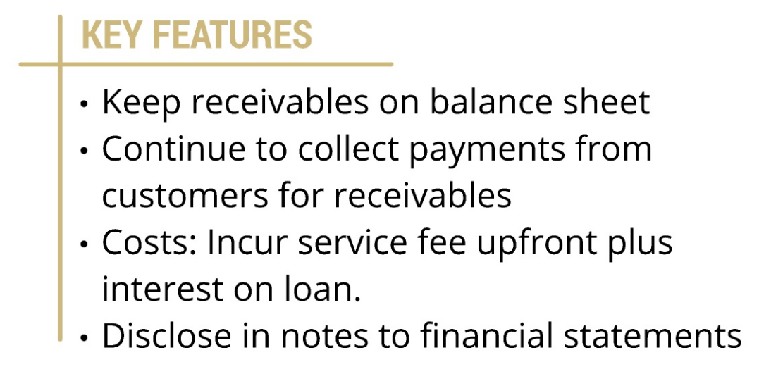
Secured Borrowing

Slide 7

Journal Entry for Secured Borrowing
Record cash proceeds from loan, financing charge as an expense, and liability outstanding

Slide 8
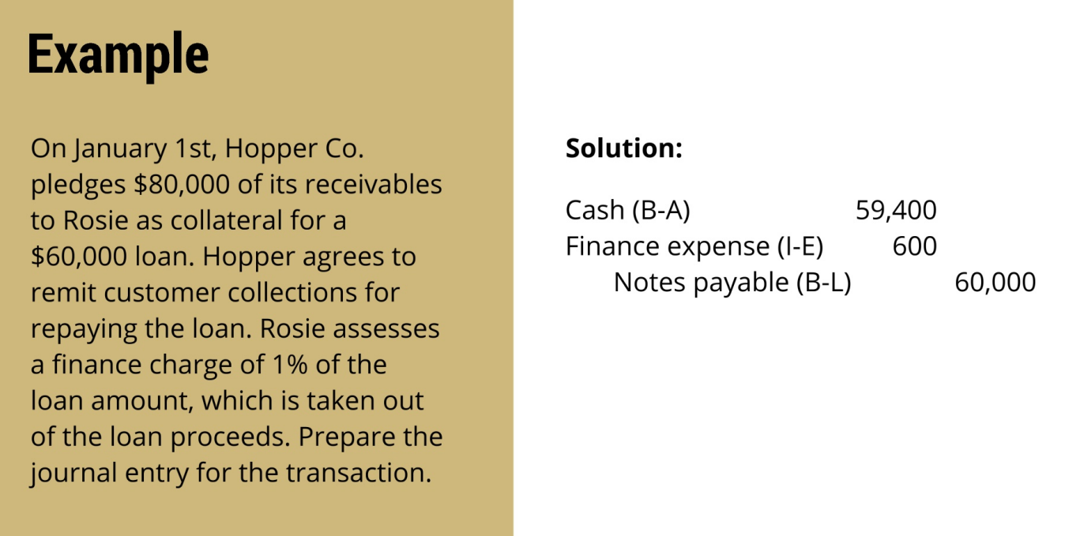

Slide 9
Closing Thoughts
Three ways to transfer receivables: secured borrowing, factoring/selling, securitizing
Secured borrowing uses receivables as collateral for a loan

Slide 10
Cash and A/R Part 2 - Video

